Slide 1

Weather Forcasting System
Rohan Ahire 20104133
Chirag Kadam 20104105
Pratham Bhagwat 20104095
Atharva Ankalwar 20104098
Project Guide
Prof. Manjusha Shelke

Slide 2
Contents
Introduction
Objectives
Scope
Features / Functionality
Project Outcomes
Technology Stack

Slide 3
1. Introduction
Weather forecasting is the application of science and technology to predict the conditions of the atmosphere for a given location and time.
There is rapid growth in the use of internet and the technologies so to help user in getting information easily on web or mobile app.
The system is an important tool used by many people for their day to day plannings.
In addition to weather forecasting, this system also includes alarm clock, stopwatch and timer which is required to the user in day to day life.

Slide 4
Problem Identified :-
Due to lack of weather forecasting system it is difficult to determine the rainfall for effective use of water resources, crop productivity and pre-planning of water resources.
Without weather prediction system it is difficult to know climatic changes such as cloud burst, cyclone and disaster.
Solution Proposed :-
Farmers need information to help them plan for the planting and harvesting of their crops.

Slide 5
2. Objectives
To manage all the information about weather and its changes at one place.
To provide detailed information of day and night temperature, climate, wind speed, humidity, pressure, sunrise and sunset time, etc to the user.
To provide information people and organizations can use to reduce weather-related losses and enhance societal benefits, including protection of life and property, public health and safety, and support of economic prosperity and quality of life.

Slide 6
3. Scope
Weather forecast can be given for few days.
Predicted temperature trends for the coming days can be shown with the help of application/Graph.
Whether application can even show hourly update of Temperature.
Weather forecasting helps us to make more informed daily decisions, and may even help keep us out of danger.
Clock has some features of Timer, Stopwatch, Digital Clock and Alarm.

Slide 7
4. Feature /Functionality
User Friendly Interface.
Useful for every category of user.
With some features of Clock.
24/7 Service.
Simple and interact user interface.

Slide 8
5. Outcome of Project
The goal of weather prediction is to provide information to people and organizations about the weather.
Can be used to reduce weather-related losses.
To make it convenient to the user to get the information of weather easily at any time.
To enhance societal benefits, including protection of life and property, public health and safety from bad conditions of weather.

Slide 9
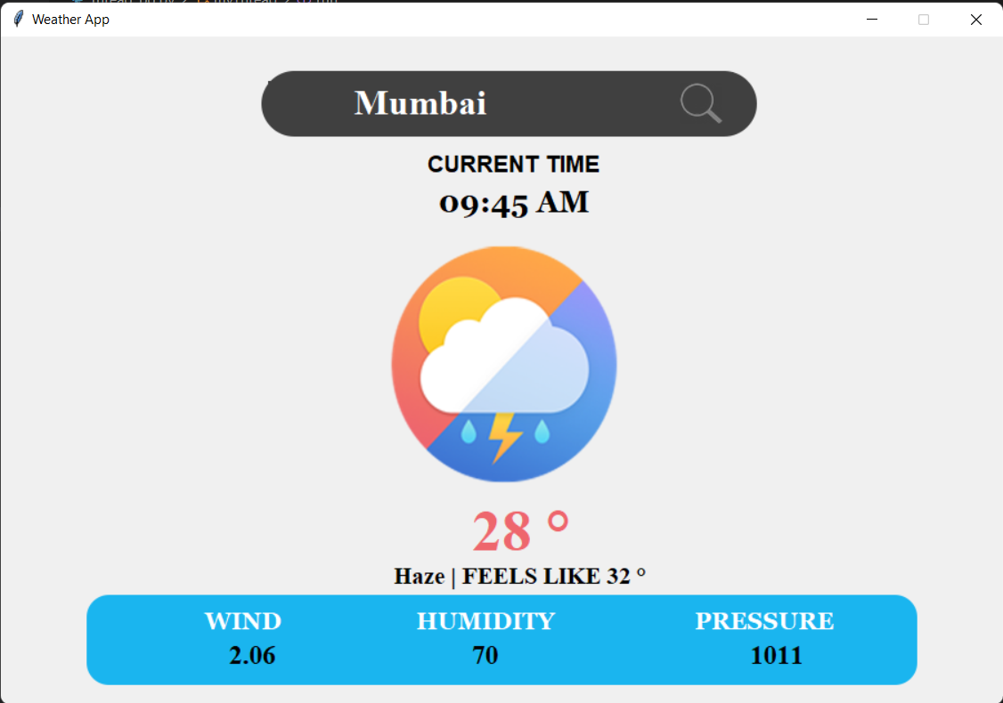
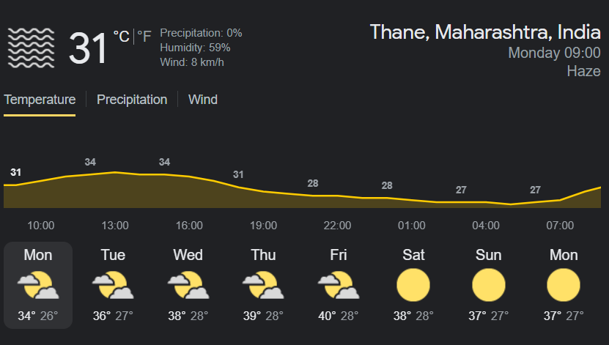

Slide 10


6. Technology Stack
Python IDE :- Vs Code
Front-end: PyQt5
Platform: Windows 10/11

Slide 11
7. Block Diagram
Start
Weather Prediction
Climate
Temperature
Pressure
Humidity
Wind Speed

Slide 12
Thank You...!!

